Slide 1
MetaMap/MTI Web API

Slide 2
MetaMap/MTI Web API
MetaMap identifies biomedical concepts in text
Medical Text Indexer (MTI) summarizes text using MetaMap and the
Medical Subject Headings
(MeSH) vocabulary
Notes:
MetaMap identifies UMLS Metathesaurus concepts – Steve Emrick discussed earlier

Slide 3
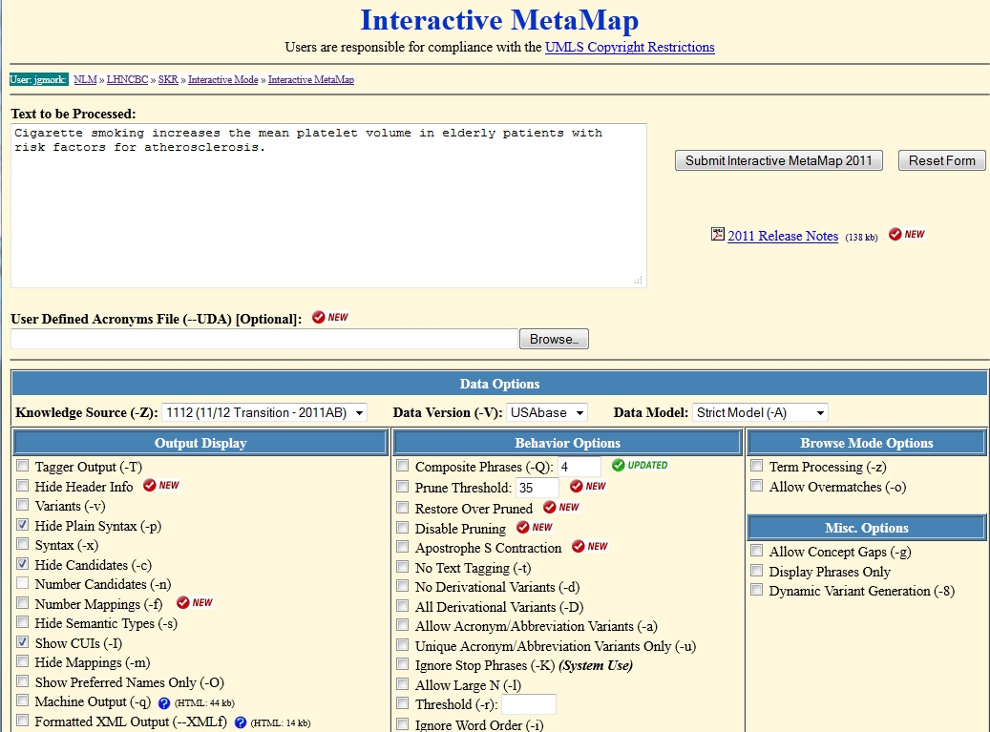
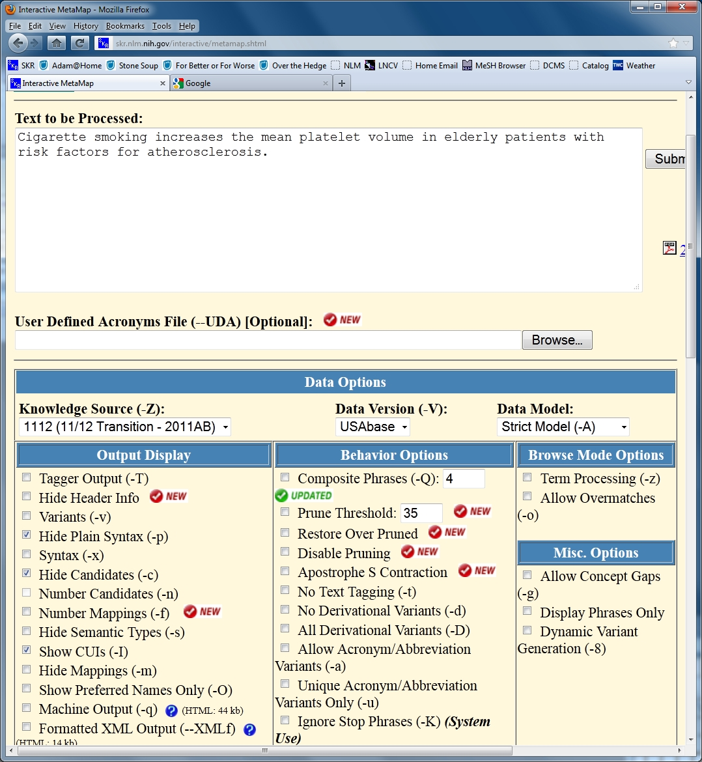

Slide 4

MetaMap/MTI Web API
Easy-to-use Java-based API providing programmatic access to both MetaMap and MTI
non-sensitive
text submitted
Your
Program
processed results
sent back
MetaMap/MTI
Web API
Notes:
If you are programming in something other then Java, the API is easy to integrate into your processing stream using one of our provided example programs.

Slide 5
MetaMap/MTI Web API
Simple code insertion
Create MetaMap/MTI Web API Object:
GenericObject myGenericObj = new GenericObject();
GenericObject myGenericObj = new GenericObject();
Set Required Fields:
myGenericObj.setField("Email_Address", "metamap@nlm.nih.gov");
myGenericObj.setField("APIText", "Cigarette smoking increases …");
myGenericObj.setField("Batch_Command", "metamap -pcI");
myGenericObj.setField("Email_Address", "metamap@nlm.nih.gov");
myGenericObj.setField("APIText", "Cigarette smoking increases …");
myGenericObj.setField("Batch_Command", "metamap -pcI");
Submit and Receive Results:
try
{
String results = myGenericObj.handleSubmission();
System.out.print(results);
} catch (RuntimeException ex) {
} // catch
try
{
String results = myGenericObj.handleSubmission();
System.out.print(results);
} catch (RuntimeException ex) {
} // catch
Notes:
Add text you would like to have processed
Set options just like on Interactive web page

Slide 6
MetaMap/MTI Web API
Batch Facility (Scheduler)
  Capacity for large sets of non-Sensitive/non-Personally Identified Information (PII) data
  Processing spread across large
  pool of computing resources
myGenericObj.setField("UpLoad_File", "./sample.txt");
Notes:
Example: MetaMapped MEDLINE database 21 million records in 8 days
No https facility for the API
Simply change one line changing “APIText” to “Upload_File” and provide a file of items to be processed.

Slide 7
MetaMap/MTI Web API Uses
Named Entity Recognition
  Identifying drugs or diseases in text
Text Indexing
  Support NLM Indexing efforts
Literature-based discovery
  Search for important undiscovered connections
2011 160,000 requests +
12,000 records nightly in-house
Notes:
Looking for specific things in literature or clinical data – for example, drugs, diseases, genes, etc.
Providing indexing recommendations to indexers, catalogers, and HMD personnel here at the U.S. National Library of Medicine
For example, Swanson was able to identify a connection between magnesium deficiency and migraines in the literature that had not been identified before
Marc Weeber, Padmini Srinivasan, and Dimitar Hristovski have use MetaMap for LBD.

Slide 8
Downloadable MetaMap
What if you do have Sensitive/PII data?
Download MetaMap and run locally
  Linux, MacOS X, Windows XP/7
  Local MetaMap API and UIMA support
  http://metamap.nlm.nih.gov

Slide 9
MetaMap/MTI Web API
Download, Documentation, and Examples:
http://skr.nlm.gov/SKR_API
Contact: metamap@nlm.nih.gov
  Requires Free UMLS Terminology Services (UTS) account: https://uts.nlm.nih.gov
Notes:
Note: complete example programs make it easy to customize for your own needs
No formal training currently available
UTS account to ensure copyright protections for the UMLS resources our tools use.
Only requirement is a yearly report on how you are using the resources. Steve Emrick
also discussed this earlier.

